Slide 1

BHAEAT NUTRAVERSE EXPO 2025, New Delhi 2025.9.4-6
Overview of Health Foods and
the Functional Claims Framework in Japan
BHARAT NUTRAVERSE EXPO 2025
Technical session on:
“Bioeconomy to Nutrieconomy: Promoting Foods as Medicine”
Date: September 4, 2025: 2:00-5:30 pm
Venue: Bharat Mandapam, New Delhi
Hideko Ikeda
Chair of the Board,
The Japanese Institute for Health Food Standards (JIHFS)

Slide 2


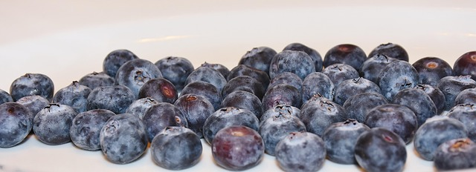

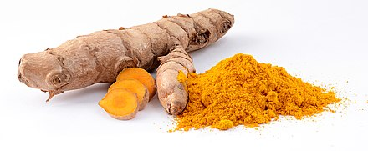
The Activities of JIHFS
Since 2005, JIHFS has been conducting the GMP certification for manufacturing facilities of raw materials and finished products.
Certification for quality assurance of imported raw materials (GMP-IM Certification) was started in 2024.
New Certification program for Safety Inspection of Raw Materials conducted by business operators will be launched soon.

Slide 3

Today’s topics
Positioning of So-called “Health Foods” and Foods with Health Claims (FHC)
The three categories fall under FHC
Foods for Specified Health Uses (FOSHU)
Foods with Nutrient Function Claims (FNFC)
Foods with Function Claims (FFC)
The importance of ensuring safety and quality in Health Foods, especially Dietary Supplements

Slide 4
So-called “Health Foods” and Foos with Health Claims (FHC)
Foods | Other so-called “Health Foods” (Any Health Claims are not permitted) | Foods with Nutrient Function Claims (FNFC) Self-Certification System | Foods with Function Claims (FFC) Notification System | Foods for Specified Health Uses (FOSHU) Individual Approval System | Drug (Including Quasi Drug)
Foods
So-called “Health Foods”
Foods with Health Claims (FHC)
There is no legal definition of the So-called “Health Foods” in Japan.
So-called “Health Foods" refer to orally ingested products other than pharmaceuticals that are either marketed as being beneficial for the maintenance or promotion of health or consumed with such expectations.
FOSHU, FFC, and FNFC, which fall under FHC under Japanese regulations, are also included in the broader category of so-called “Health Foods".
Other so-called ”Health Foods” are not permitted to make any health claims.

Slide 5
Today’s topics
Positioning of So-called “Health Foods” and Foods with Health Claims (FHC)
The three categories classified under FHC
Food for Specified Health Uses (FOSHU)
Foods with Nutrient Function Claims (FNFC)
Foods with Function Claims (FFC)
The importance of Safety and Quality Assurance in Health Foods, especially Dietary Supplements

Slide 6


FOSHU
Foods for Specified Health Uses
(Individual approval system, 1991~)
FOSHU
Approval system
Clinical study with the food!
needs time and cost
……
FOSHU mark

Slide 7
Application for FOSHU - Main requirements that must be clarified by the applicant -
Efficacy and Safety
In vitro, animal studies, and human clinical studies using the food
Functional Food aiming for FOSHU
Subjects (Health condition, sex, age, number of subjects, etc.)
Ingestion method (Duration and dosage, etc.)
Study design (Appropriateness of the design, generally RCT)
Identification of functional ingredient
Chemical experiments
Mechanism of action
In vitro and animal studies
Absorbability in the digestive tract
Internal kinetics (absorption, metabolism, excretion, and accumulation in the body)
Mechanism of action (Based on the latest information and experimental methods）
Establishment of quantitative test methods
Guarantee of the content
Physical and chemical properties as food constituents
Clarification of raw material and ingredients
Four kinds of FOSHU (2001~)
Ordinary FOSHU
Standardized FOSHU
Qualified FOSHU
FOSHU with Disease Risk Reduction Claims
Approved after deliberation by the CAA and the FSC (Food Safety Commission).
Source: Lecture Material by Makoto Shimizu (Professor Emeritus at the University of Tokyo) for Health Food Forum February, 2024 organized by ASIW (Association for Health Economics Research and Social Insurance and Welfare）

Slide 8
FOSHU - Functional claims, Food types and Functional ingredients
Functional claim category | Examples of food type | Examples of functional ingredients
Promotes gut health | Powdered soft drink, Probiotic drink | Dietary fiber, Oligosaccharide, bacteria
Promotes tooth and gum health | Chewing gum | Sugar alcohol, tea polyphenol, milk protein digests, funoran, isoflavone, calcium, macrocarpal
Enhances mineral absorption | Soft drink | Casein phosphopeptide, oligo saccharide, poly γ-glutamic acid,
Promotes bone health and strength | Soft drink, Fermented soybeans | Milk basic protein, isoflavone, vitamin K2
Alleviates skin drying | Soft drink | Glucosylceramide
Lowers blood pressure | Soft drink, Compressed tablet candy | Food protein-derived peptide, γ-aminobutyrate, acetic acid, chlorogenic acid, glucosyl hesperidin, quercetin, glycoside
Reduces blood glucose levels | Soft drink, Green tea-based drink | Indigestible dextrin, indigestible recrystalized amylose, wheat albumin, tea polyphenol, arabinose, thiocyclitol
Reduce blood cholesterol levels | Powdered soft drink, Processed soy milk | Soybean protein, chitosan, low molecular weight alginate, phytosterol, tea catechin, S-methylcysteine sulfoxide
Reduce blood neutral lipid levels and body fat | Adjusted cooking oil, Coffee drink | Tea polyphenol conjugate, globin digest, indigestible dextrin, catechin, conglycinin, n-3 PUFA*, glucosylhesperidin
 |  | (* n-3 PUFA: n-3 polyunsaturated fatty acid)
Source: Makoto Shimizu, Nutraceutical and Functional Food Regulations in the United States and around the World. Third Edition. p. 338, 2019.

Slide 9
FNFC
Foods with Nutrient Function Claims
(Self-certification system, 2001~)
FNFC
Essential Nutrients
Vit & Min
n-3 fatty acids
……

Slide 10
What is FNFC?
FNFC aims to supply the nutrients that are essential for growth, development, and overall health.
The selection of nutrients and the wording of their functional claims are determined by the government based on well-established medical and nutritional evidence.
The approved nutrients include 13 vitamins, 6 minerals, and unsaturated n-3 fatty acids.
If a product’s daily intake of each nutrient falls within the specified range and the labeling requirements are met, functionality claims can be made without government approval or notification.
FNFC operates as a self-certification system.
Vitamins | A, B1, B2, B6, B12, C, D, E, K, biotin, pantothenic acid, folic acid, and niacin.
Minerals | Calcium, Iron, Zinc, Copper, Magnesium, Potassium (To avoid the risk of excessive intake of potassium, foods such as tablets and capsule formulations are excluded.)
Unsaturated n-3 fatty acids

Slide 11
Nutrients and function claims of FNFC
Nutrient | Upper limit Lower limit | Nutrient function claim |  | Nutrient | Upper limit Lower limit | Nutrient function claim
n-3 fatty acids | 2.0g 0.6g | N-3 fatty acids are nutrients that help maintain skin health. |  | Vitamin A | 600μg 231μg | Vitamin A is a nutrient that helps maintain night vision. Vitamin A is a nutrient that helps maintain the health of the skin and mucous membranes.
Zinc | 15mg 2.64mg | Zinc is a nutrient necessary for maintaining normal taste sensation. Zinc is a nutrient that helps maintain the health of the skin and mucous membranes. Zinc is a nutrient that is involved in the metabolism of proteins and nucleic acids, contributing to the maintenance of health. |  | Vitamin B1 | 25mg 0.36mg | Vitamin B1 is a nutrient that aids in the production of energy from carbohydrates and helps maintain the health of the skin and mucous membranes.
Potassium | 2,800mg 840mg | Potassium is a nutrient necessary for maintaining normal blood pressure. |  | Vitamin B2 | 12mg 0.42mg | Vitamin B2 is a nutrient that helps maintain the health of the skin and mucous membranes.
Calcium | 600mg 204mg | Calcium is a nutrient necessary for the formation of bones and teeth. |  | Vitamin B6 | 10mg 0.39mg | Vitamin B6 is a nutrient that helps maintain the health of the skin and mucous membranes.
Iron | 10mg 2.04mg | Iron is a nutrient necessary for the production of red blood cells. |  | Vitamin B12 | 60μg 0.72μg | Vitamin B12 is a nutrient that helps the formation of red blood cells.
Copper | 6.0mg 0.27mg | Copper is a nutrient that help production of red blood cells. Copper is a nutrient that helps the proper functioning of many internal enzymes and the formation of bones. |  | Vitamin C | 1,000mg 30mg | Vitamin C is a nutrient that helps maintain the health of the skin and mucous membranes, while also possessing antioxidant properties.
Magnesium | 300mg 96mg | Magnesium is a nutrient necessary for the production of red blood cells. Magnesium is a nutrient necessary for helping the proper functioning of many internal enzymes, energy production, and maintaining normal blood circulation. |  | Vitamin D | 5.0μg 1.65μg | Vitamin D is a nutrient that promotes the absorption of calcium in the intestines and helps with bone formation.
Niacin | 60mg 3.9mg | Niacin is a nutrient that helps maintaing the health of the skin and mucous membranes. |  | Vitamin E | 150mg 1.89mg | Vitamin E is a nutrient that protects the body's lipids from oxidation and helps maintain cellular health , through its antioxidant properties.
Pantothenic acid | 30mg 1.44mg | Pantothenic acid is a nutrient that helps maintain the health of the skin and mucous membranes. |  | Vitamin K | 150μg 45μg | Vitamin K is a nutrient that maintains normal blood clotting ability.
Biotin | 500μg 15μg | Biotin is a nutrient that helps maintain the health of the skin and mucous membranes. |  | Folic acid | 200μg 72μg | Folic acid is a nutrient that helps the formation of red blood cells. Folic acid is a nutrient that contributes to the normal development of the fetus.

Slide 12
FFC
Foods with Function Claims
(Notification system, 2015~)
FFC
Systematic review for functional claims!
Product info is on the government Website
……

Slide 13

Basic concept of FFC and the notification procedure
System for conducting post-marketing checks | Information on safety and efficacy of a product, and others has to be submitted to the Commissioner of Consumer Affaires Agency (CAA） The notified information on the product is disclosed on the website of the CAA.
Systematic literature review or clinical trial is acceptable for the functional claims | Clinical trial(s) with the finished product is not essential requirement.
Detail labelling rules were established | Disclamer “Unlike FOSHU, this product has not been individually evaluated by the Commissioner of CAA” must be described. (The rest of the details are omitted.)
Fresh foods are also the subject of FFC
Notification procedure for FFC
60 days* before the start of sales
Submission of documents by a food business operator to the CAA.
Formal confirmation of the notified documents by the CAA.
Publication of the notified documents on the CAA’s website
Marketing
Details of the product labelling
Basic information of a food business operator (Name and contact details, etc.)
Scientific evidence of safety and efficacy
Information on manufacturing and quality management of the product.
Adverse events collection system
Other necessary information
Food business operator
Appropriate quality control
Collecting information on adverse events, etc.
Collecting new information, etc.
The administ-
ration
Collecting information on adverse events, etc.
Instructions, orders or public announcements based on food labelling (e.g. measures to prevent the distribution of dangerous products)
Post-marketing operations
* In the case of new ingredients,
120 days in advance

Slide 14
Number of Products of FOSH and FFC
※The figures represent the cumulative number of approvals/notifications as of the end of each fiscal year (excluding cancellations and withdrawals). Source: CAA

Slide 15
FFC (Examples of the labelling contents of functional ingredients with the highest number of notifications)
Functional substance | Notified Functional Claims
GABA | This product contains GABA. GABA has been reported to have beneficial effects for individuals with slightly high blood pressure. This product contains GABA. It has been reported that GABA may alleviate temporary mental stress associated with office work.
Indigestible dextlin | This product contains indigestible dextrin. Indigestible dextrin (Dietary fiber) has been reported to help regulate gastrointestinal function.
Lutein and Zeaxanthin | This product contains lutein and zeaxanthin. Lutein and zeaxanthin have been reported to increase and maintain macular pigment in the eye, supporting contrast sensitivity (visual function to discriminate shades of colour and reduce blurring and haze), glare recovery (visual function to recover from glare), alleviate light stress such as blue light, temporary mental stress, reduce eye fatigue, and improve sleep quality.
DHA, EPA | This product contains DHA and EPA. DHA and EPA have been reported to have the ability to lower triglycerides.
Polymethoxyflavones in black ginger | This product contains polymethoxyflavones derived from black ginger. Polymethoxyflavones derived from black ginger has been reported to reduce abdominal fat (visceral fat and subcutaneous fat) in individuals with higher BMI (BMI 24 or above but less than 30) by promoting the consumption of fat during daily activities, thus enhancing energy metabolism.
Ginkgo biloba flavonoid glycosides and Ginkgo biloba terpene lactones | This product contains ginkgo leaves-derived flavonoid and ginkgo leaves-derived terpen lactones. Ginkgo leaves-derived flavonoid glycosides and ginkgo leaves-derived terpene lactones have been reported to improve the accuracy of memory (the ability to remember and recall information encountered in daily life) and judgment, which are part of cognitive functions that decline with aging in healthy middle-aged and elderly individuals.
Astaxanthin | This product contains astaxanthin. Astaxanthin has been reported to assist in the regulation of eye focusing function and to alleviate fatigue caused by activities such as computer work. Additionally, astaxanthin has been reported to assist in preserving the moisture of the skin.

Slide 16
FFC (Example of functional claims of FFC: The Product containing Ginkgo biloba extract)
Functional substance | Notified Functional Claim
Ginkgo biloba flavonoid glycosides and Ginkgo biloba terpene lactones | This product contains ginkgo leaves-derived flavonoid and ginkgo leaves-derived terpen lactones. Ginkgo leaves-derived flavonoid glycosides and ginkgo leaves-derived terpene lactones have been reported to improve the accuracy of memory (the ability to remember and recall information encountered in daily life) and judgment, which are part of cognitive functions that decline with aging in healthy middle-aged and elderly individuals.
This term indicates that the functional claim has been established by a systematic review.

Slide 17
Today’s topics
Positioning of So-called “Health Foods” and Foods with Health Claims (FHC)
The three categories classified under FHC
Food for Specified Health Uses (FOSHU)
Foods with Nutrient Function Claims (FNFC)
Foods with Function Claims (FFC)
The importance of Safety and Quality Assurance in Health Foods, especially Dietary Supplements

Slide 18




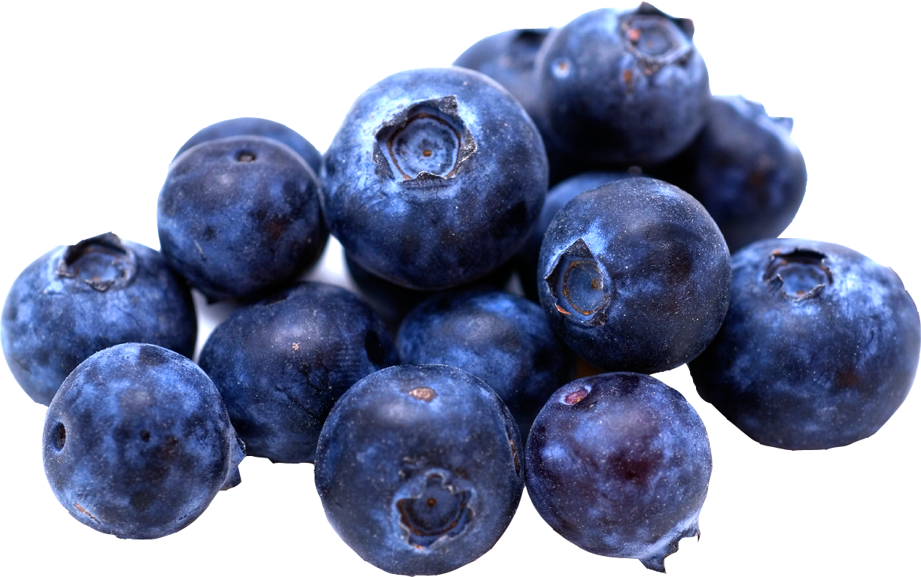
Guidelines for Safety Self-Inspection of Dietary Supplement Raw Materials and
Appropriate product design, and GMP Guideline
( The Notification issued by the MHLW in 2005 and revised in 2024 )
Processing
(Formulation)
Source
material
Processing
Raw material
Other ingredients
(such as safety confirmed functional ingredients and/or excipients)
Extraction , fractionation, purification, concentration or drying, etc. from natural products
Chemical synthesis
Final
product
Safety Self-Inspection of Raw Materials
GMP is also recommended for raw materials
１
２
３
Appropriate product design
GMP
Basic procedure for confirming the raw material safety
１
Confirm history of safe use (consumption record)
Collect and assess safety and toxicity information on source materials, raw materials and their components through literature searches.
If safety cannot be guaranteed on the basis of 1 and 2 above, toxicity studies shall be conducted using the raw material, etc.

Slide 19

Mandatory implementation of GMP
Foods | Other so-called “Health Foods” (Any Health Claims are not permitted) | Foods with Nutrient Function Claims (FNFC) Self-Certification System | Foods with Function Claims (FFC) Notification System | Food for Specified Health Uses (FOSHU) Individual Approval System | Drug (Including Quasi Drug)
Foods
So-called “Health Foods”
Foods with Health Claims (FHC)
GMP is still voluntary.
GMP has been made
mandatory in 2024.

Slide 20
Three essential elements for Health Foods/Dietary Supplements
Supplements/Health foods
Efficacy
Safety
Scientific evidence
Quality
(Based on GMP)
Labelling with claims

Slide 21


Thank you for your attention.

